Slide 1
Trigger Trace
Link every asthma attack to the air around it
THEME: SDG 3 – GOOD HEALTH AND WELL-BEING
TEAM NAME : HEAL 4 ALL
1 . SUDHARSHANA . V
2 . DIKSHNA . S
3 . MOHAMMED AADHIL .F
4 . PREETHAM . G
1

Slide 2
1 . Problem Statement
• Asthma patients are told to “avoid your triggers” — but many do not know their own.
• Triggers vary by person: air pollution, humidity, temperature changes and seasons.
• Attacks can feel random, making it difficult to plan ahead.
• Weather apps show general conditions, not conditions linked to a person’s attacks.
• Paper diaries and long symptom forms often miss environmental information.
• Doctors may have to rely on patient memory, giving an incomplete picture.
2

Slide 3
2 . Proposed Solution
• One-tap “Attack now” logs the time and location immediately after an attack.
• Caregivers can also record attacks for children or older adults.
• Environmental data is automatically attached: PM2.5, humidity, temperature and rainfall.
• Pattern view compares attack days with symptom-free days.
• Doctor-ready one-page summary shows dates, severity and possible patterns.
• Flexible logging: back-dated entries and evening check-ins.
Capture
Enrich
Compare
Visualise
Share
3

Slide 4
3 . Innovation / Uniqueness
Existing solutions
• Weather and air quality apps are not personalised.
• Symptom diaries ignore the environment.
• Forms are too long to fill at the moment of an attack.
Our approach
• Links personal attacks with environmental data automatically.
• Designed for right after an attack: one tap once you feel better, details later.
• Uses symptom-free days as a baseline, so patterns aren’t based only on bad days.
• Caregiver logging for children and older adults.
• Shows possible patterns with a confidence note, never claimed causes.
4

Slide 5
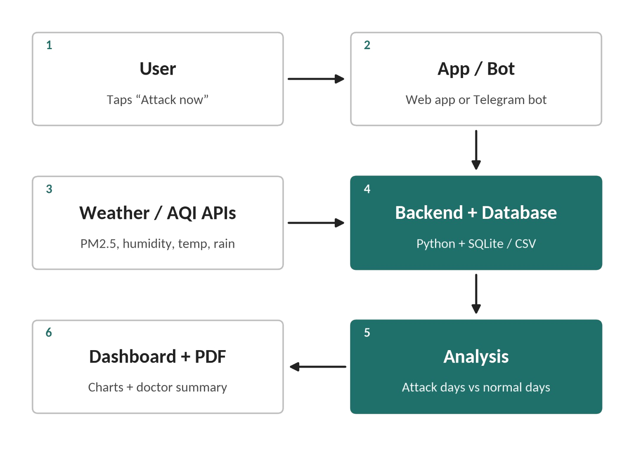
4 . Technical Approach
Input: installable mobile web app (PWA) with one-tap “Attack now” for logging.
Data: public weather and air-quality APIs for PM2.5, humidity, temperature and rainfall.
Backend: Flask API with SQLite database, plus scikit-learn and pandas for analysis.
Analysis: daily table of attack days vs. symptom-free days, using L2 logistic regression on PM2.5, humidity, temperature and rainfall (same-day and lagged), with odds ratios and bootstrapped ranges, plus an attack-rate comparison as a check.
Confidence Score: patterns shown only after 10+ attacks and 30+ check-in days; otherwise “not enough data”.
Output: pattern charts and a PDF summary.
Privacy: only district-level location is stored; demo uses synthetic data.
5

Slide 6
5 . Feasibility & Implementation
• Uses free public APIs, keeping the cost low and avoiding special hardware.
• Prototype demonstrates the full flow using 90 days of synthetic data.
• Phase 1: Prototype with synthetic data.
• Phase 2: Test with a few volunteers for 1–2 weeks.
• Phase 3: Pilot with a clinic.
• Retention ideas: one-tap logging, evening reminders and a useful doctor summary.
• Safety: use the inhaler first and follow the asthma action plan; log afterwards. The app gives no diagnosis or treatment advice.
6

Slide 7
6 . Expected Impact / Beneficiaries
Who benefits
• People with asthma, especially those with frequent attacks.
• Parents and caregivers of children, and older adults.
• Doctors, who get reliable, organised history.
What changes
• Better awareness of personal triggers and fewer surprise attacks.
• More useful doctor visits.
• Supports SDG Target 3.4 (managing chronic conditions) and Target 3.9 (health effects of air pollution).
7

Slide 8
7 . Future Scope
• Hands-free logging using smart inhaler sensors.
• Smartwatch-based detection and voice logging.
• Tamil and other regional-language support.
• Clinic pilot to measure real-world usage.
• Telegram and WhatsApp channels for users without smartphones.
• Pooled, anonymized data to strengthen pattern detection.
• Extend the same approach to migraines, allergies, eczema .
8

Slide 9
Thank You
Know your triggers. Prevent the next attack.
9

